Slide 1
Neapolitan Solutions Presents:
Ice Cream Tracker

Slide 2
Team Overview
Project Manager: Tyler Callison
Test Manager: Tyler Padgett
Design Manager: Dylan James,
Software Manager: Dylan James
Configuration Manager: Drew Meade
QA Manager: Mario Inzunza-Grivel
Requirements Manager:Cole Kincaid

Slide 3
Demonstration overview
Project Overview:
Project goal and Requirements
Tools
Estimated size and schedule
Risks Assessment and Mitigation
Project architecture
ER Diagram
UI Designs
Test methods and levels
Increment 1 Scope
Future releases
Software demo

Slide 4
Project Overview: Project Goal and Requirements
Major requirements split into components with specific tasks:
Order Entry:
Subsystem maintains customer information.
Multiple items can be included in the same order based on availability.
Inventory should be updated based on items ordered.
Login:
Users are only granted access to subsystems they’re authorized.
Inventory Management:
Grant different permissions to users based on account type.
Inventory availability validation.
Modify inventory based on incoming orders.
Forward product spoilage and out of stock notifications to Trouble Ticket Management module.
Shipment Tracking:
Update customer portals with the latest information on products in transit.
Forward shipping errors to Trouble Ticket Management module.
Trouble Ticket Management:
Collect errors at all stages of runtime for later corrective action.
Audit/Log:
Store all inventory changes performed by a user.
Store all incoming orders from the Order Entry module.
Store a record of ticket changes in Log module.
Ice Track software product is a web-based shipment tracking and inventory management system for Tom and Adam’s Ice Cream Company.

Slide 5
Project Overview: Methodology and Risk Identification
Software Engineering Method:
Architected Agile software development: Optimal for small, custom applications for small businesses.
Risks:
Developer inexperience:
React is a new framework for a significant portion of the development team.
Firebase database system is a new tool for the development team.
Schedule risk:
Early stages of development have already seen significant schedule adjustments.
Staff, skills, and systems are not tracked properly.
Mitigations:
JIRA holds team members accountable and highlights tasks that slip from schedule.
Meetings allow more experienced developers to diffuse their knowledge to the rest of the team.

Slide 6
Project Overview: Tools
React Native framework:
Cross platform development
Firebase backend services:
Authentication
Real-time database
Development software:
IDEs:
Visual Studio Code
Version control:
Bitbucket
Task and Requirement tracking:
JIRA
Deployment platform:
Web application (Google Chrome, Mozilla Firefox, Safari or Microsoft Edge).

Slide 7
Project Overview: Estimated size and schedule
Size Estimate, using Application Point Sizing:
Inventory Management System
Orders
Trouble Tickets
Changelog
Total: ~9 screens, 2 client data tables + 6 server data tables.
Labor Hours estimate:
160 total man hours (40 per 3rd level task)

Slide 8
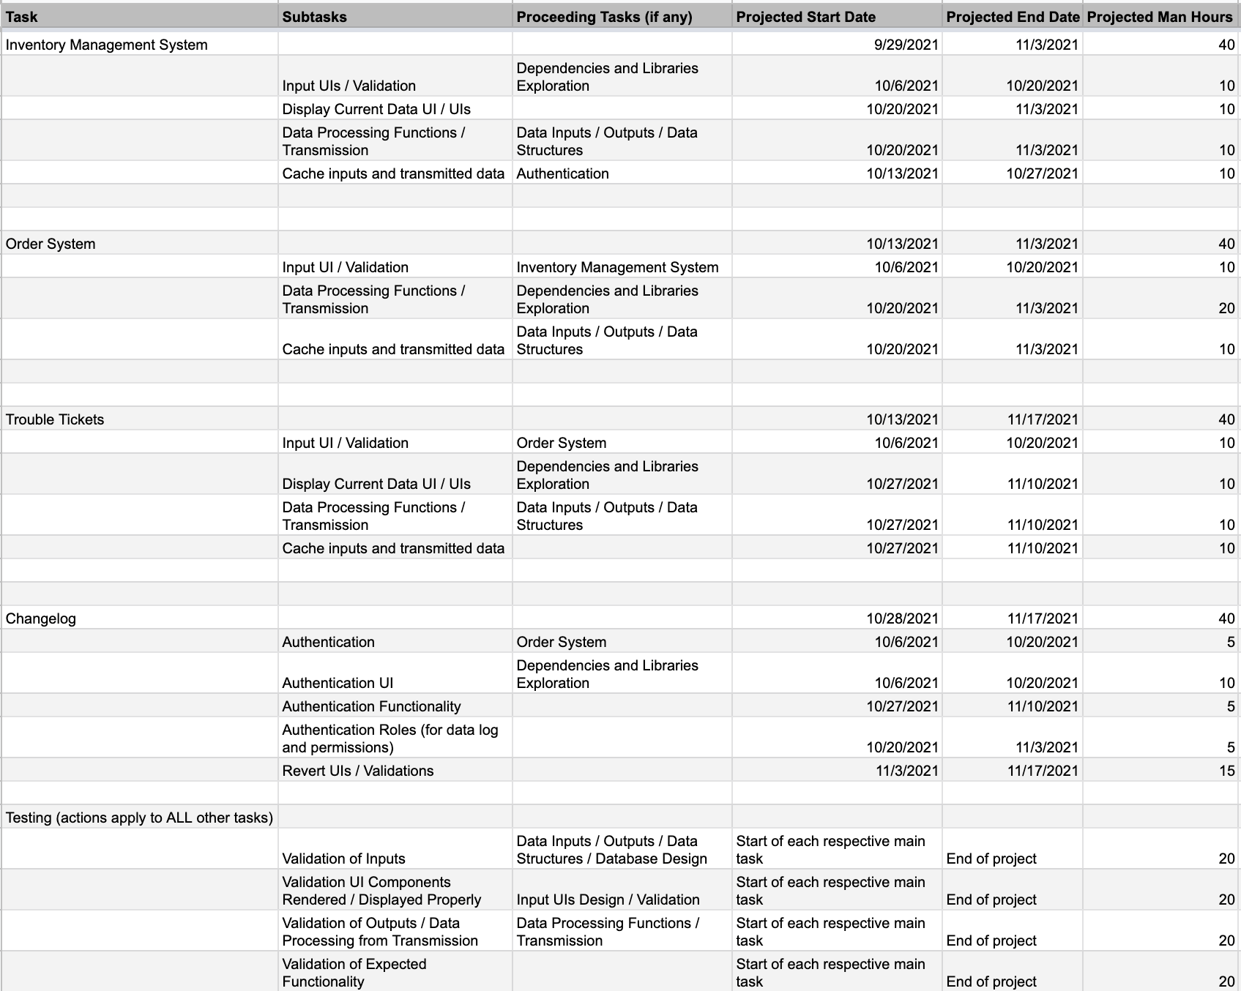
Project Overview: Estimated size and schedule

Slide 9
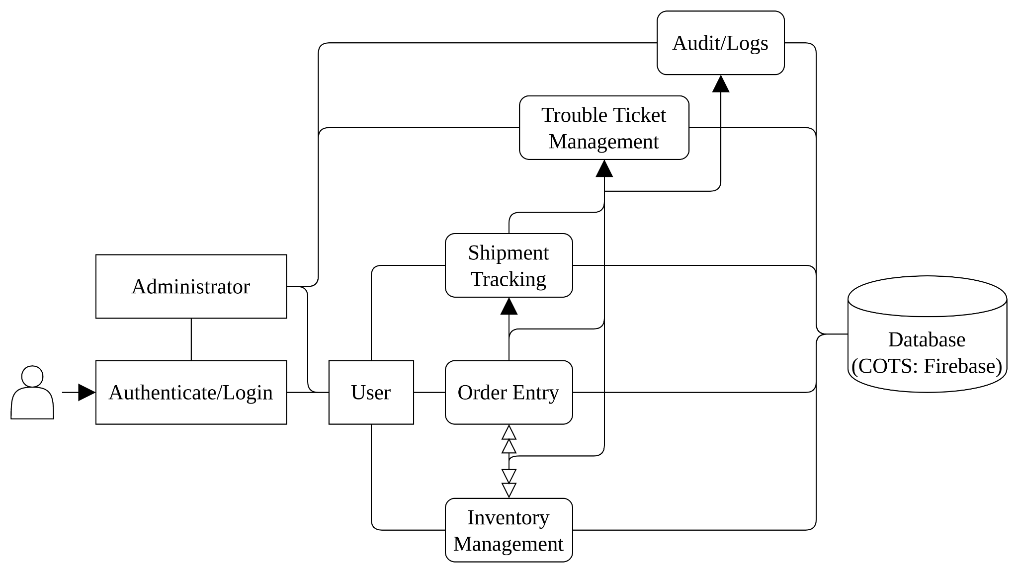
Project Overview: Project architecture
Pipe and filter design:
Incoming user requests will be directed to the appropriate module to indirectly interact with Firebase database.

Slide 10
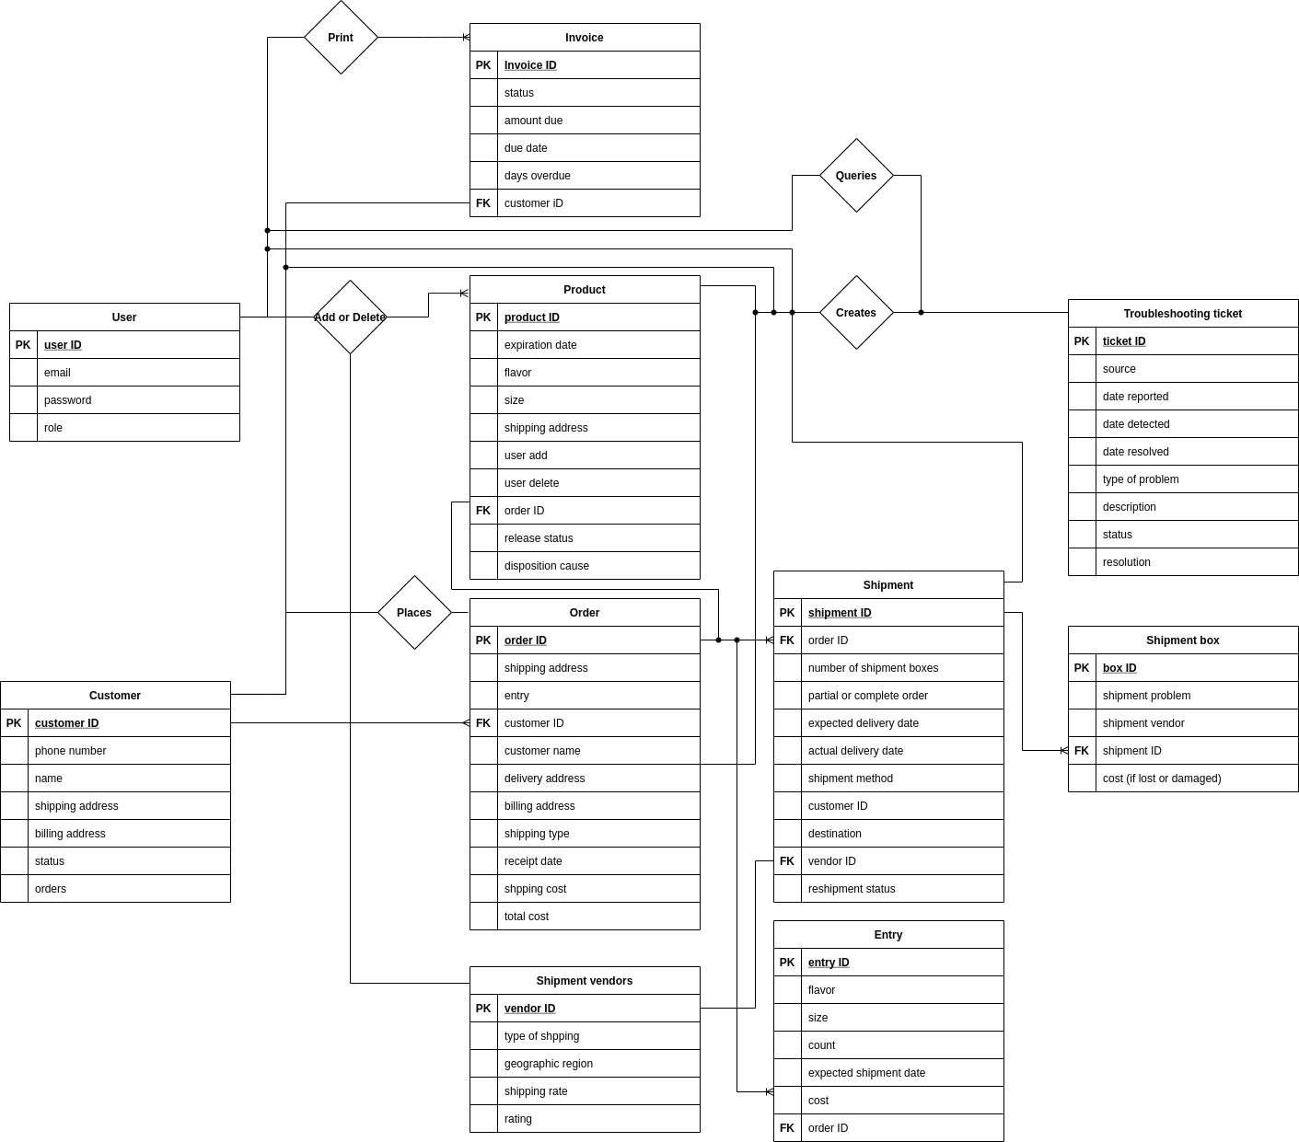
ER Diagram

Slide 11
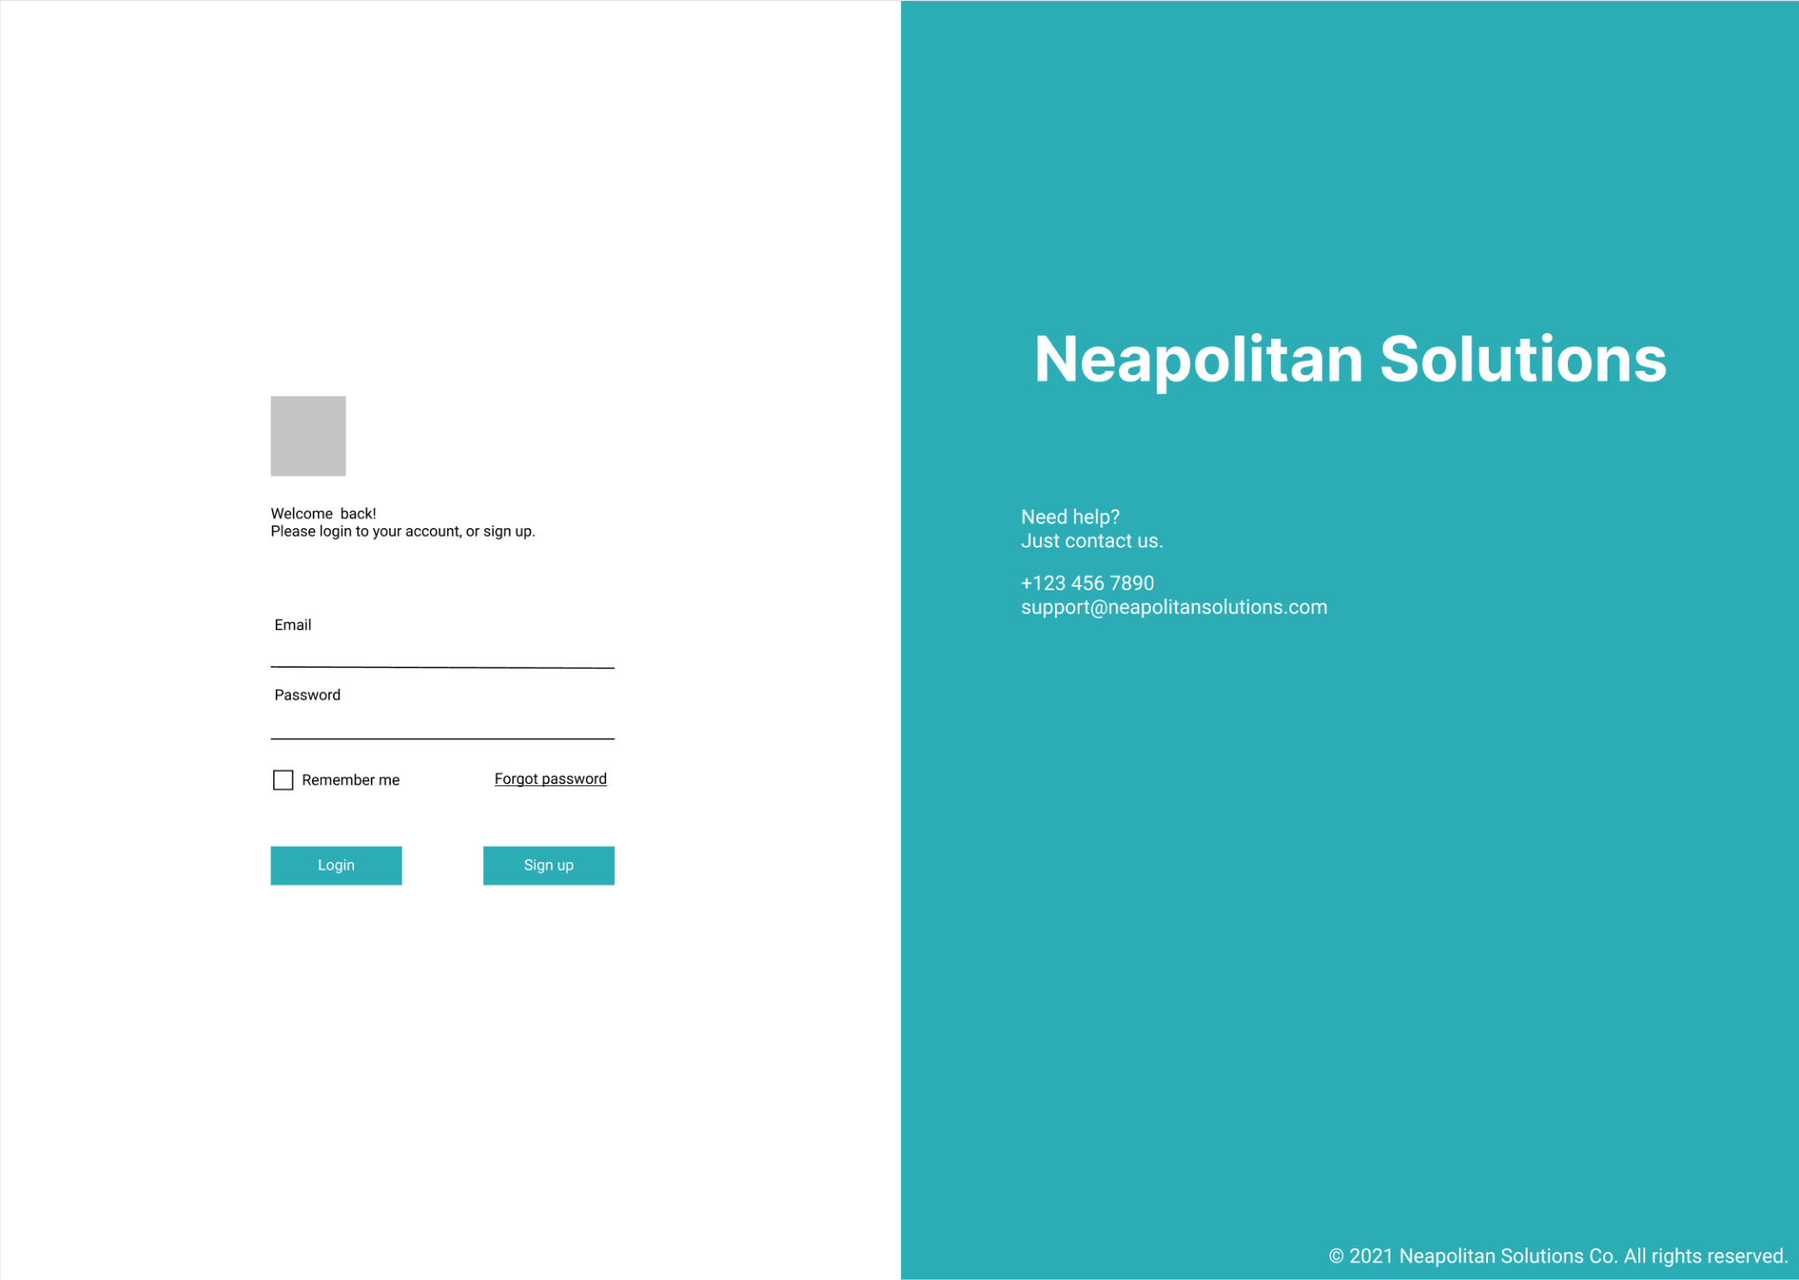
UI Design Overview: General UI Elements
System-wide Navigation Bar
IceTrack Login Screen

Slide 12
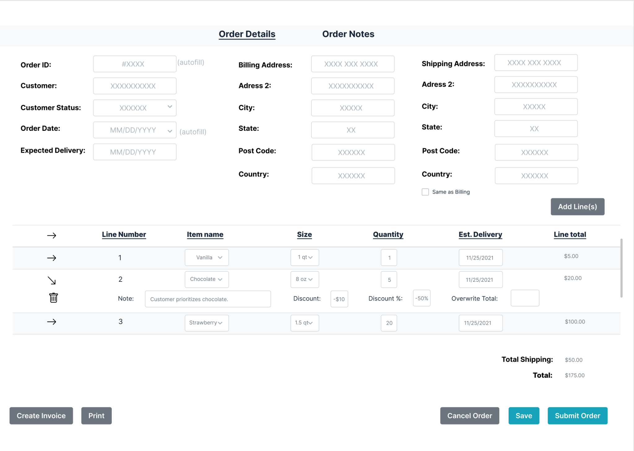
UI Design Overview: Order Entry

Slide 13
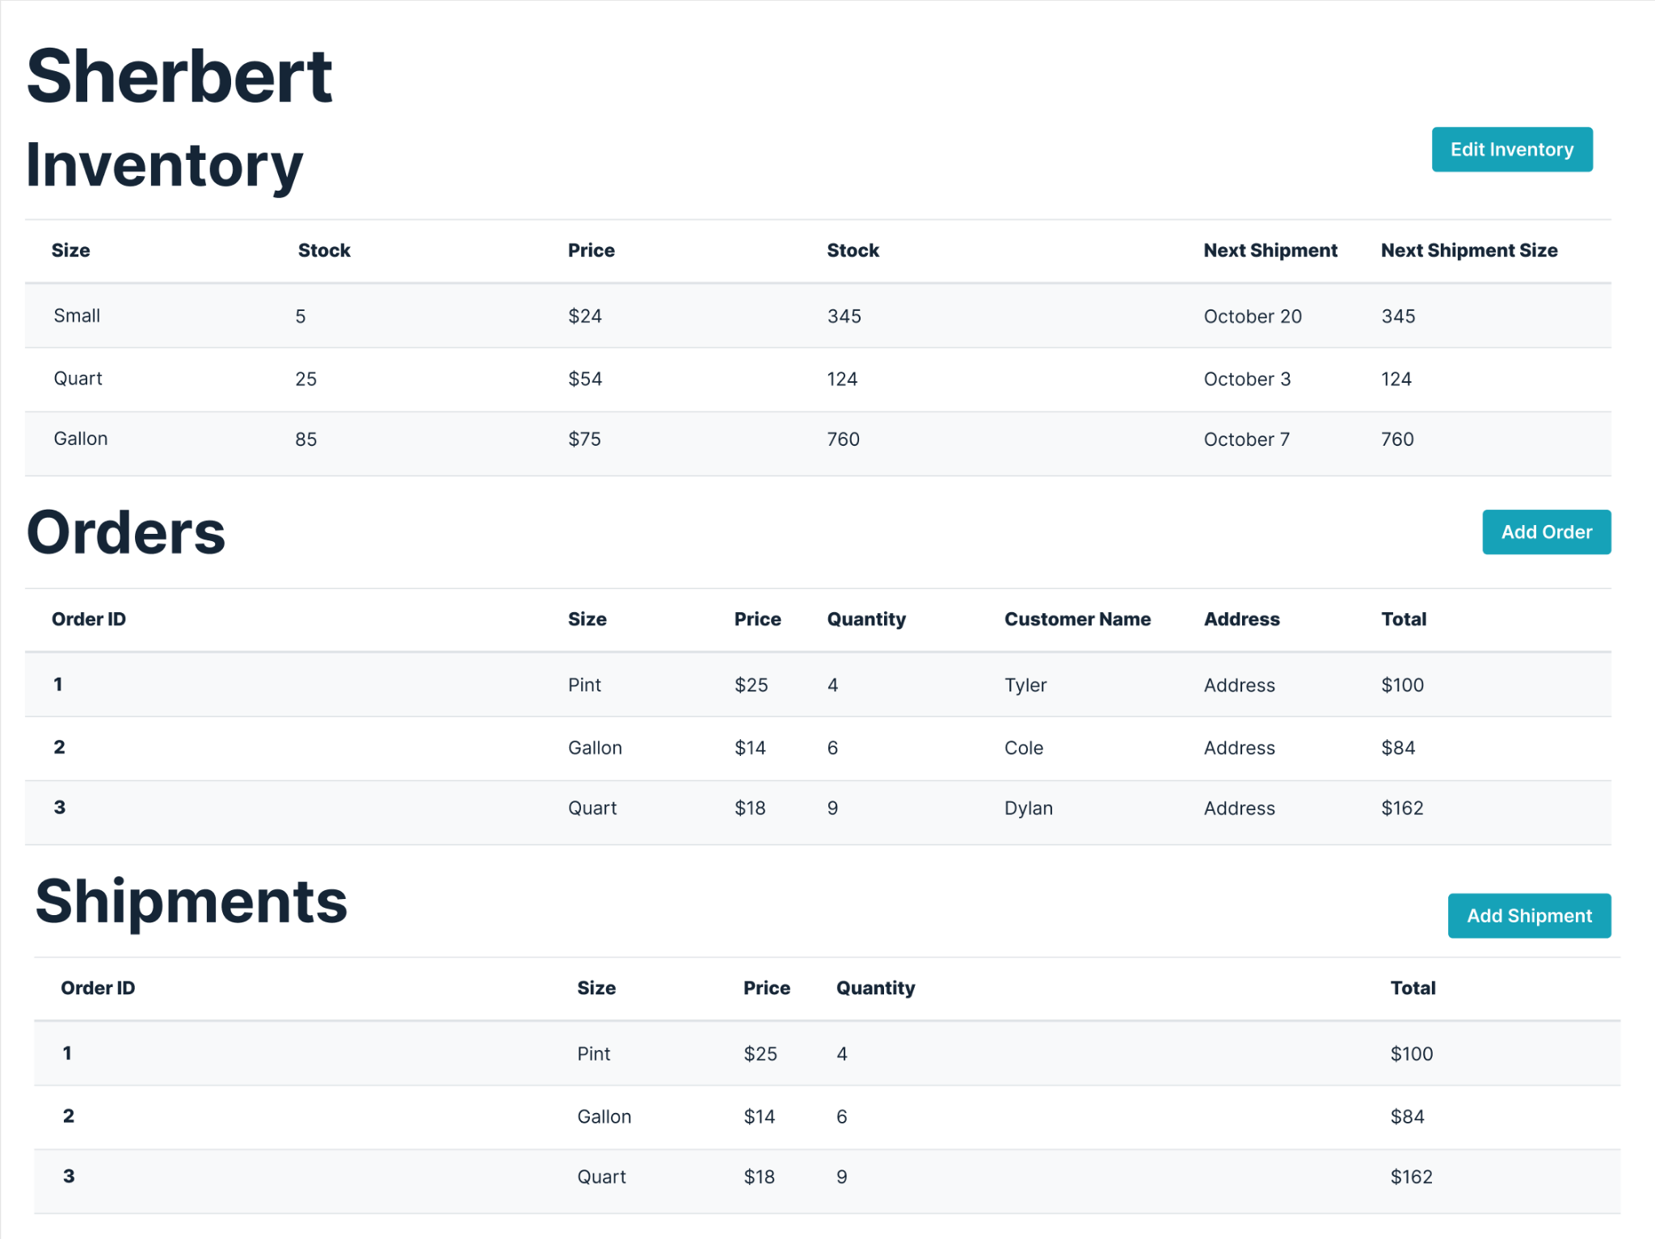
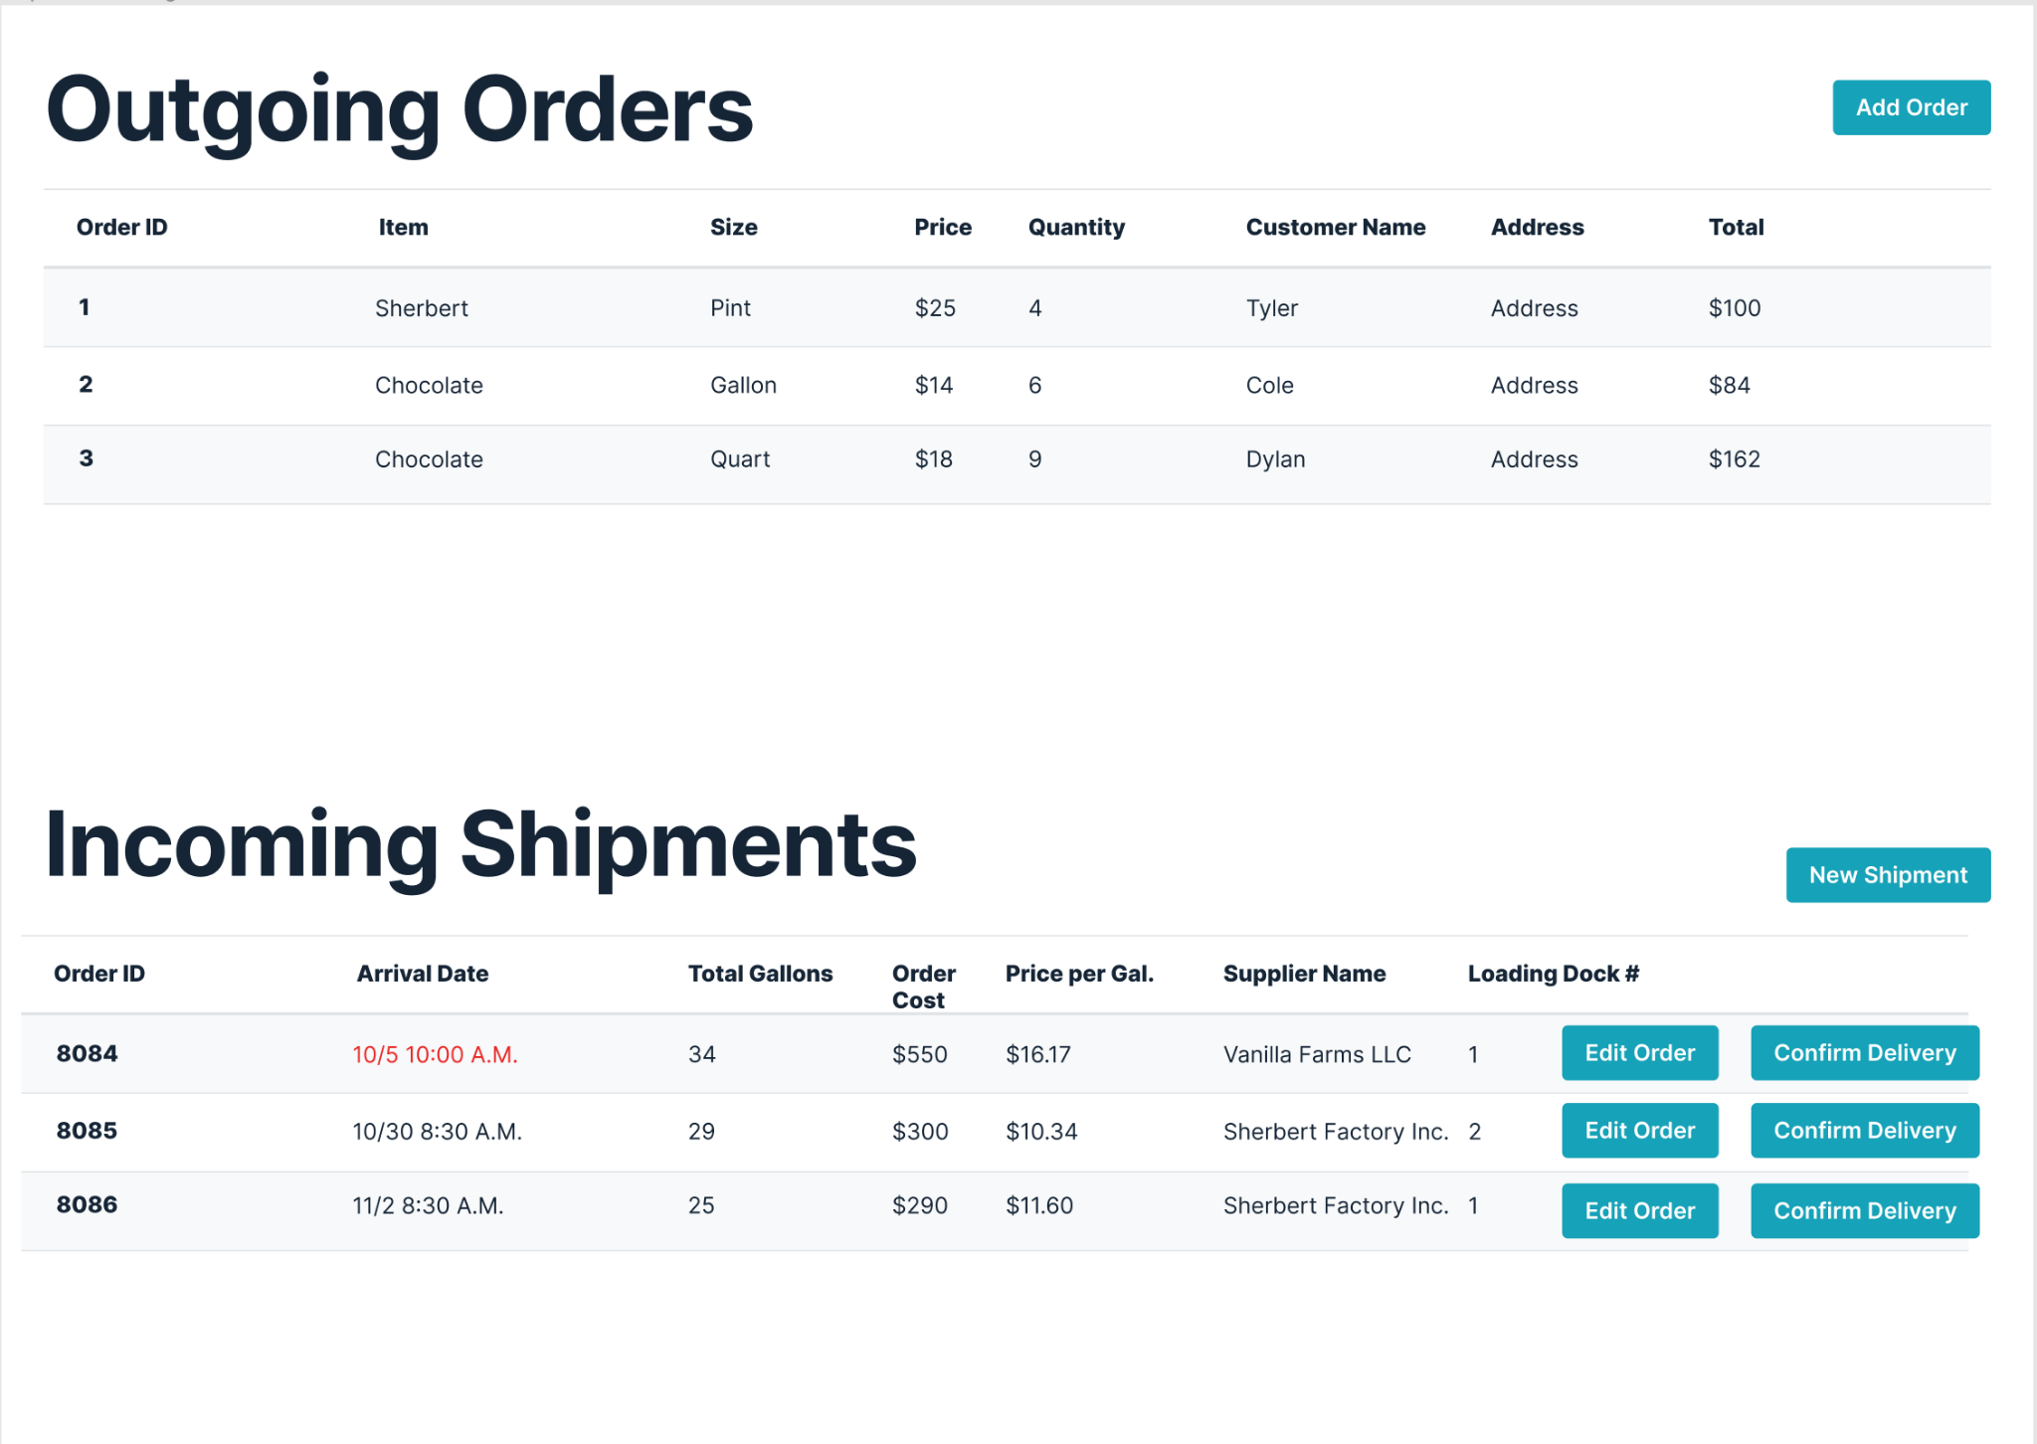
UI Design Overview: Shipment Tracking

Slide 14
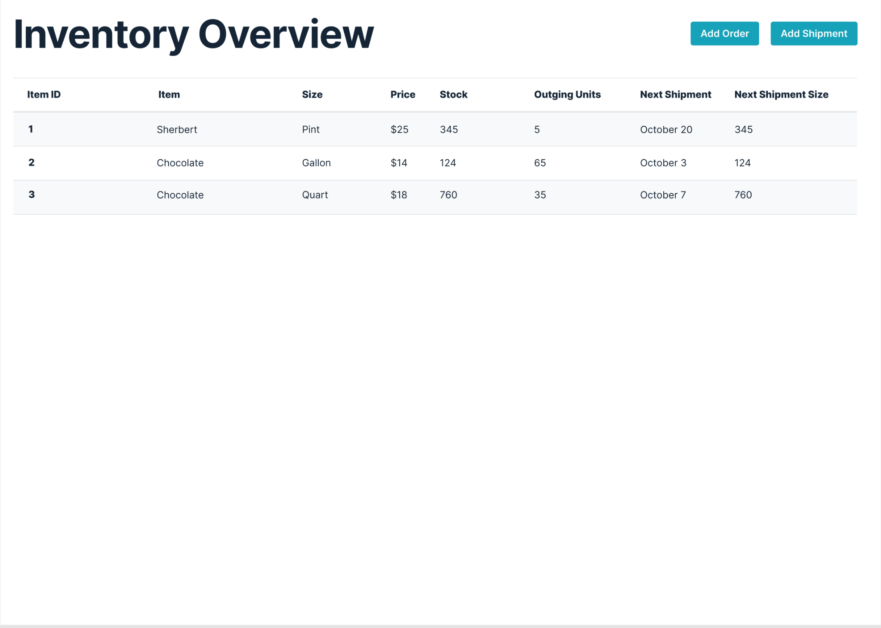
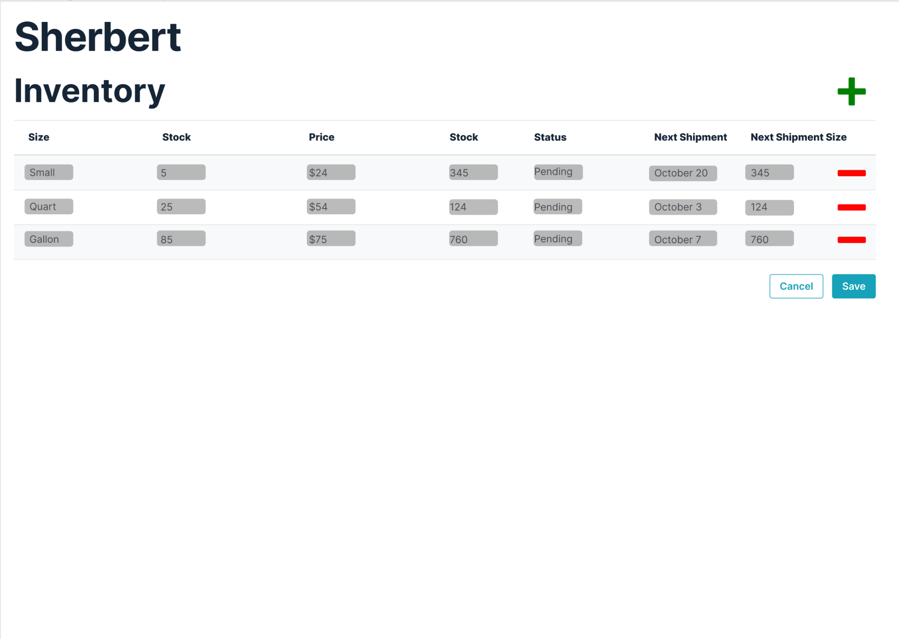
UI Design Overview: Inventory Management

Slide 15
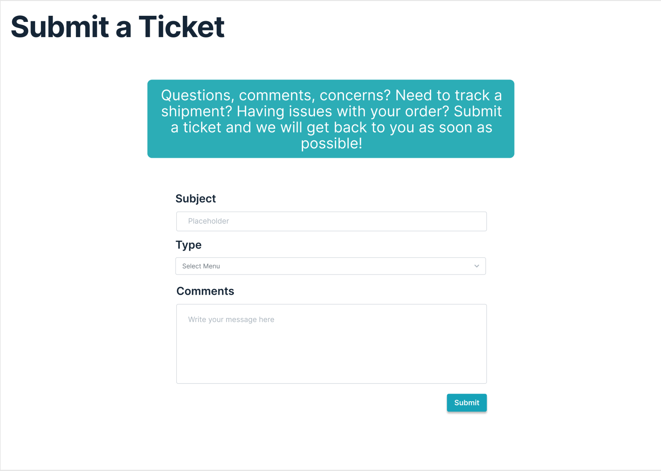
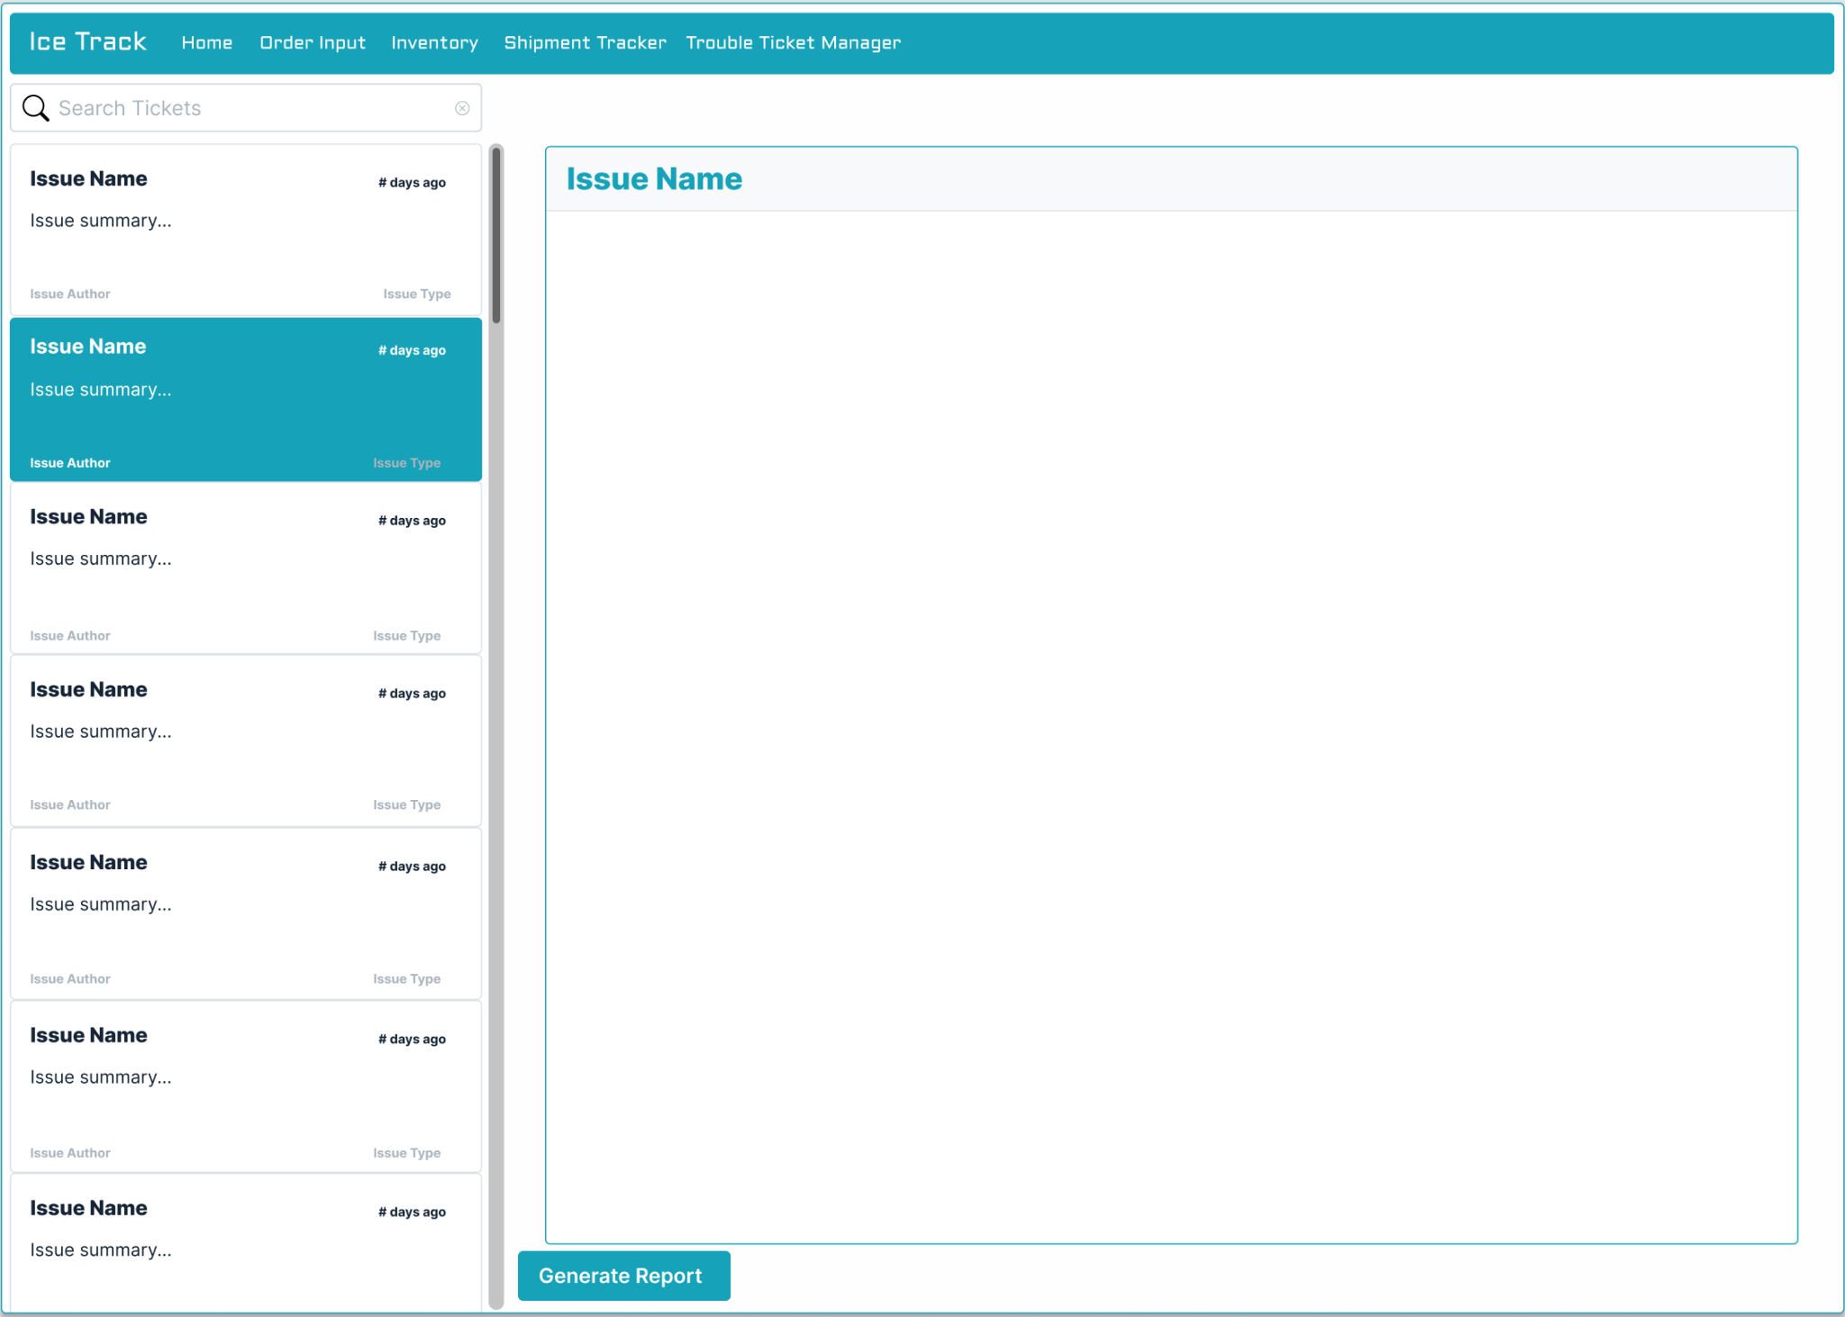
UI Design Overview: Trouble Ticket Management

Slide 16
Test methodology
Inventory Tests
Objectives: Confirm that the inventory system functions as intended and can be edited by authorized users.
Black box testing: Database testing.
Pass/fail criteria:
1) Verify all users can view inventory and privileged users can modify inventory.
2) Module tracks product count, size, flavor, user modifications, and incoming shipments.
3) Module notifies trouble ticket management system after product spoilage or defect.
4) Data remains intact and not corrupted between queries.
Order Placement Tests:
Objectives: Ensure the order placement system functions as intended and interacts with the inventory system correctly when a customer places an order.
Black box testing: Security-relevant testing, Database testing and Comparison testing.
Pass/fail criteria:
1) Module updates inventory based on new orders.
2) Login portal for customers is secure and users only access authorized subsystems.
3) Database tests reflect inventory changes according to incoming orders
Constraints and Assumptions: There are no concurrent orders being placed.

Slide 17
Test methodology
Shipment Tracking Tests:
Objectives: Verify the module tracks outgoing shipments and shipment tracking information is kept up-to-date on customer portals. Any problems detected during transit are automatically forwarded to the trouble ticket management system.
Black box testing: Comparison and security-relevant testing.
Pass/fail criteria:
1) Customers always have the latest status of their shipped orders.
2) Customers aren’t able to view the status of another customer’s order.
Constraints and Assumptions: Dummy shipment data will be used for testing purposes.
Trouble Ticket Management Tests:
Objectives: Module records any errors that occur at all stages of system runtime.
Black box testing: Stress, Comparison, and Security-relevant testing.
Pass/fail criteria:
1) The system can process many trouble tickets placed in a short amount of time without compromising performance.
2) In the event of duplicate incoming tickets, only one is recorded for later analysis.
3) Users are restricted from reading administration-only data in troubleshooting tickets.

Slide 18
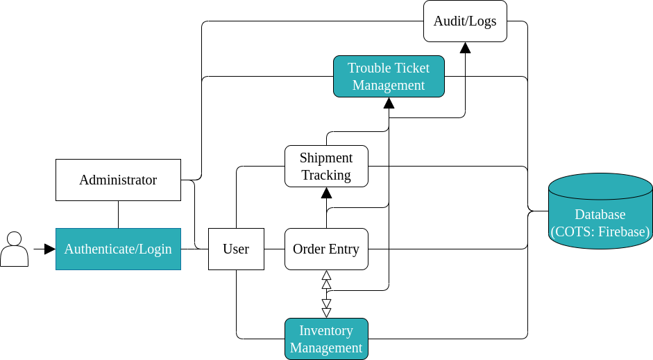
Increment 1: Scope
Authentication / Account management system.
Login screen with Firebase API backend to perform account creation and login authentication. [b.i]
Trouble Ticket Management
Ticket creation and viewing. [e.i]
Inventory management
Product entry by users. [c.i]
Finalize screen designs. [f.i]
First increment focused on:
Security access
Screens/User Interface navigation
Trouble ticket management
Authentication

Slide 19
Future Releases
Increment 2
Order Entry:
Accept orders for multiple flavors and sizes. [a.ii]
Customer information is maintained for future orders. [a.i]
Inventory management:
Inventory availability validation. [c.ii]
Modify inventory based on incoming orders.[c.iii]
Shipment Tracking:
Track and update customer portals with the latest information on orders in transit. [d.i]
Forward errors to Trouble Ticket management module. [d.ii]
Increment 3
Audit / Logs:
Store all inventory changes performed by a user. [f.i]
Store all incoming orders from the Order Entry module. [f.ii]
Store a record of ticket changes in Log module. [f.iii]
Inventory Management:
Forward product spoilage and out of stock notifications to Trouble Ticket Management module. [c.iv]

Slide 20
Demonstration overview
Project Overview:
Project goal and Requirements
Tools
Estimated size and schedule
Risks Assessment and Mitigation
Project architecture
ER Diagram
UI Designs
Test methods and levels
Increment 1 Scope
Future releases
Software demo

